Slide 1
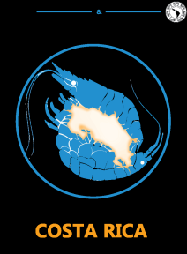


A paradigm shift in biodiversity publishing: mobilization, mark up, reuse and integration of small data
The Crustacean Society & The Latin American Association of Carcinology
7 -11 July 2013 – San José, Costa Rica
Lyubomir D. Penev^{1,3}, Teodor A. Georgiev³, Pavel E. Stoev^{2,3}, Jordan Bisserkov³, Laurence Livermore⁴, Jeremy Miller ⁵, David M. Roberts⁴ & Vincent S. Smith⁴
1 Institute for Biodiversity and Ecosystem Research, Bulgaria
2 National Natural History Museum, Bulgaria
3 Pensoft Publishers
4 The Natural History Museum, UK
5 NCB Naturalis, Leiden, The Netherlands
pensoft.net/journals/bdj
ViBRANT

Slide 2
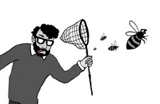
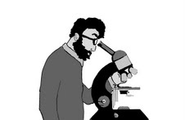

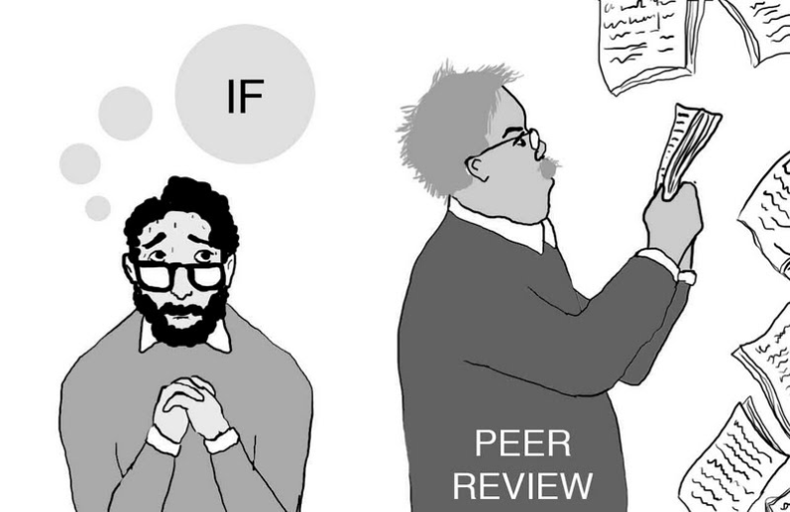
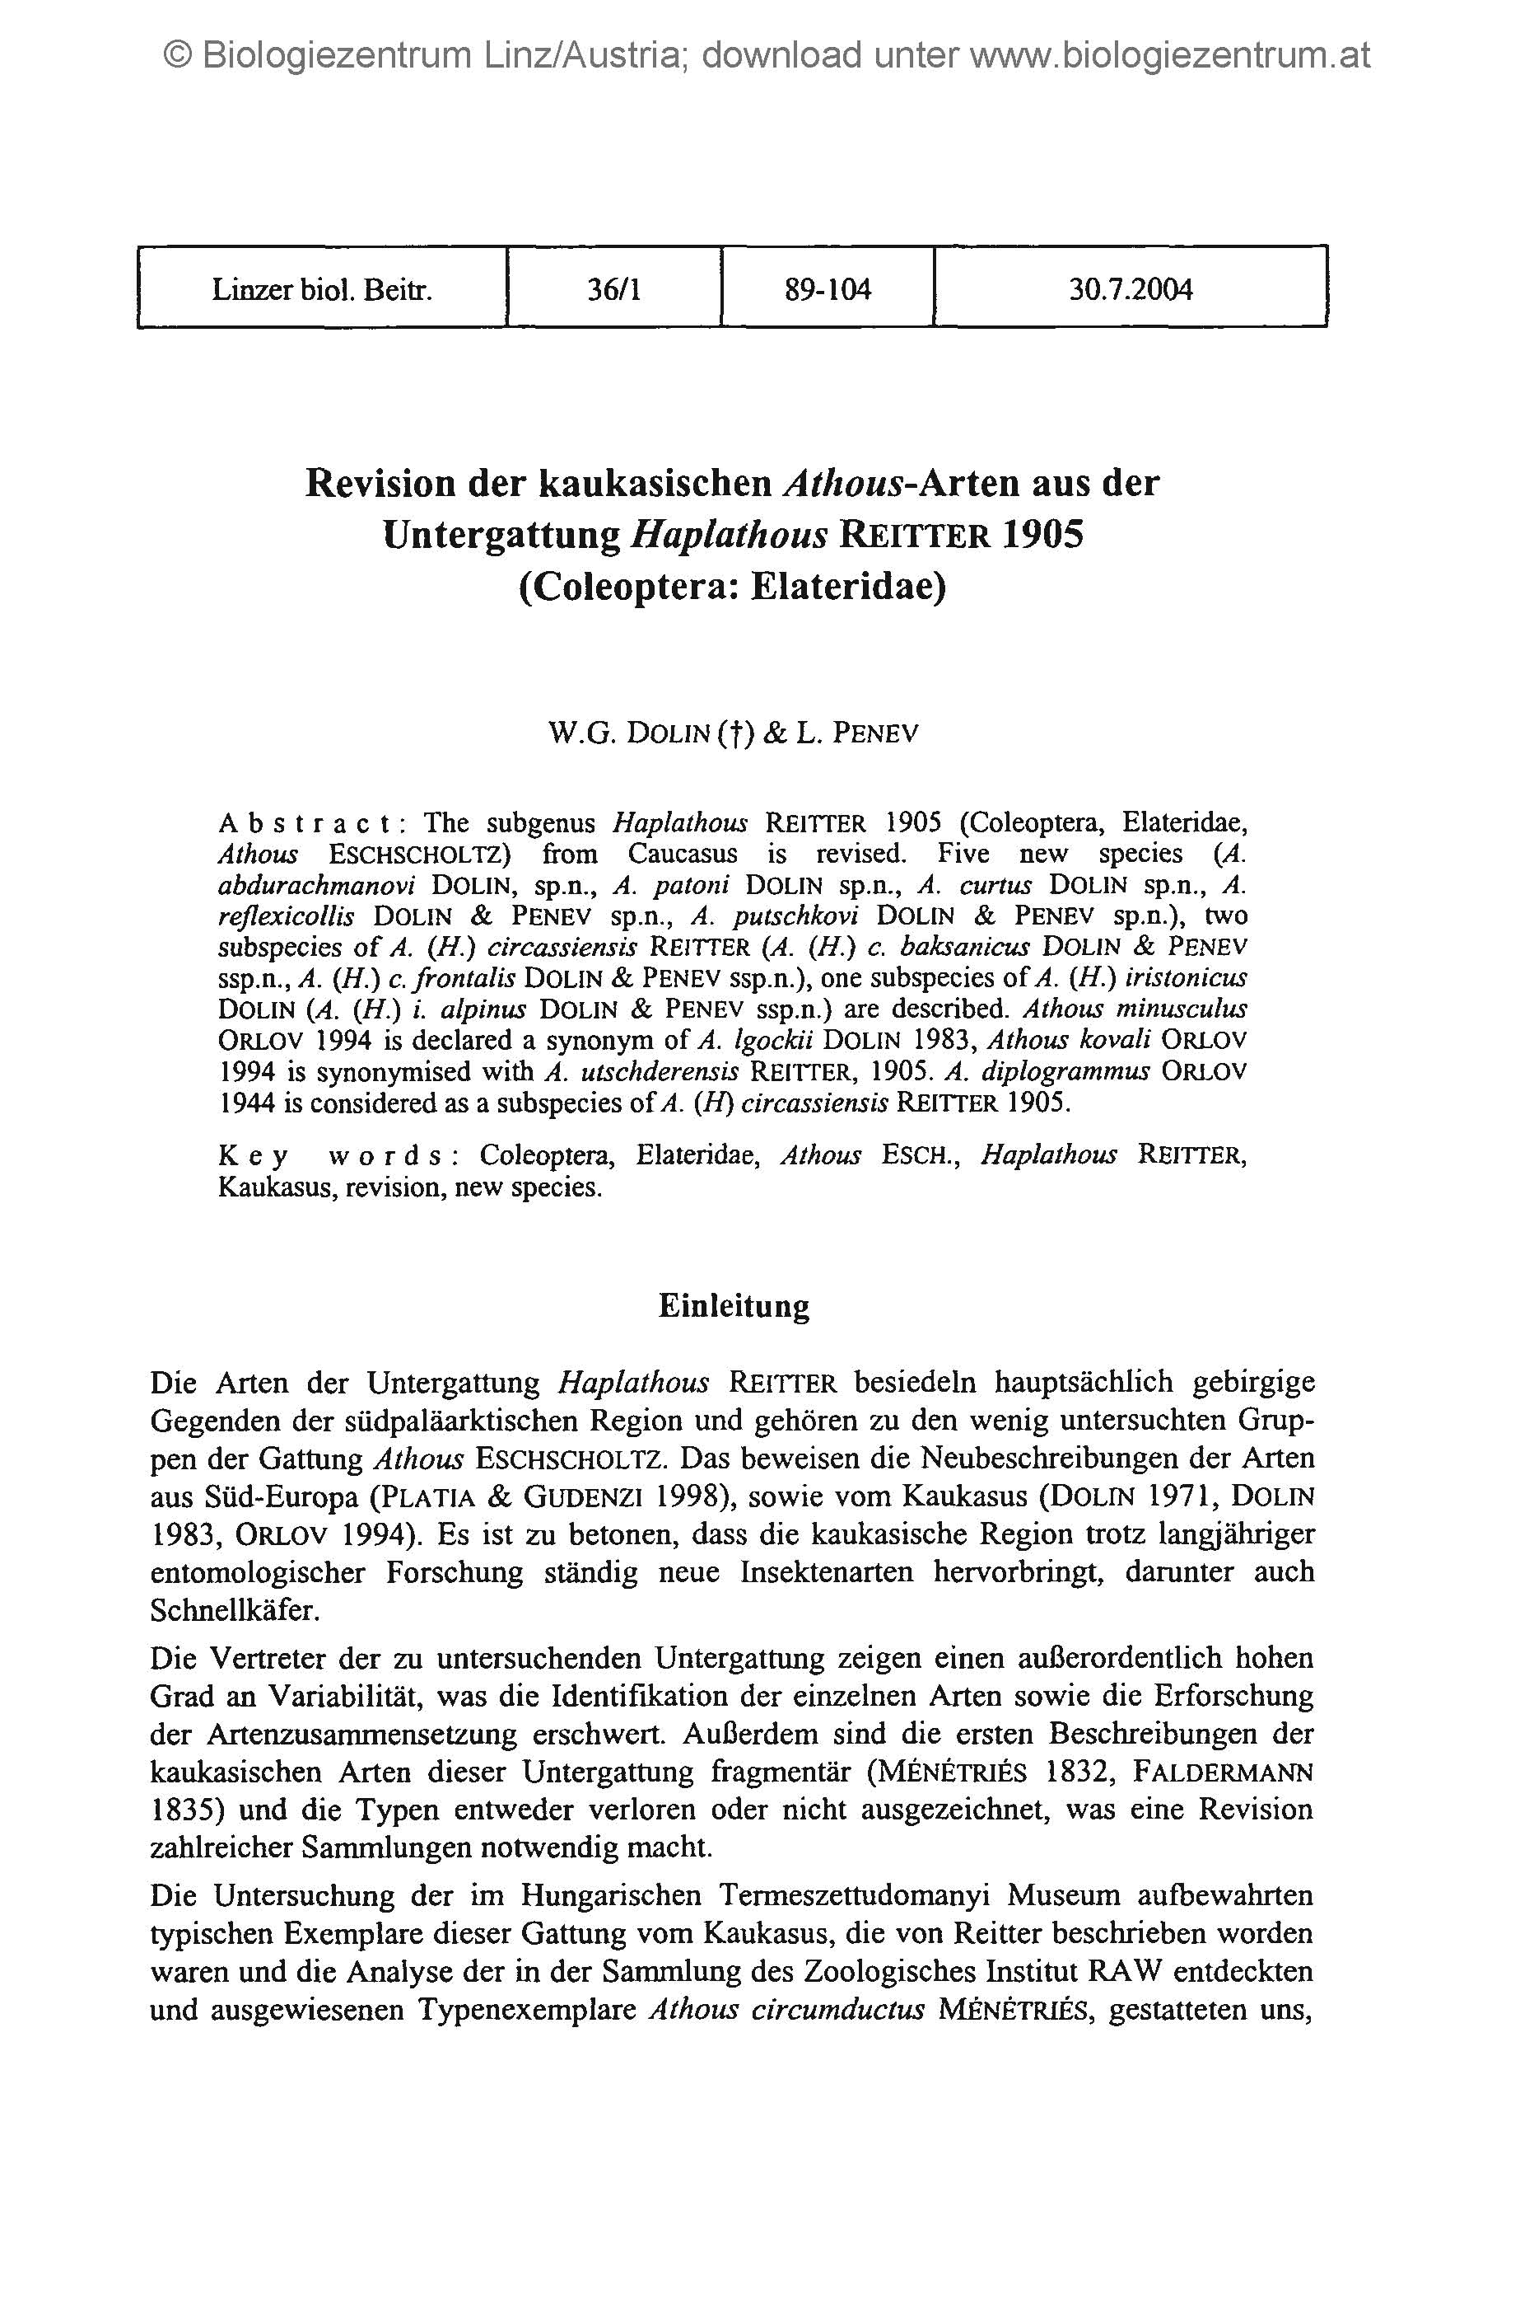




Drawings: slavenapeneva.com
Primary data

Slide 3
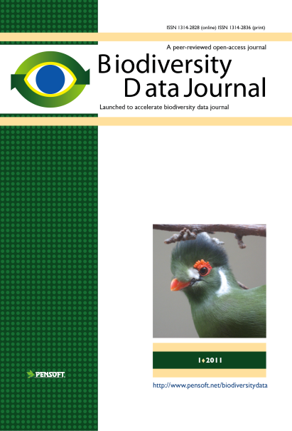
RE-USE
of
CONTENT
Publishing and sharing of primary data
Primary data

Slide 4
Data publishing becomes increasingly important and already affects the policies of the world’s leading science funding frameworks and organizations.
The concept of “open data” is described in the Protocol for Implementing Open Access Data, the Open Knowledge/Data Definition, the Panton Principles for Open Data in Science, and the Open Data Manual.
27
Notes:
4

Slide 5
White House Office of Science and Technology Policy (OSTP) created the Big Data Research and Development Initiative started 29 March 2012
Directive of the Council of Europe recognising “the strategic importance for Europe’s scientific development of open access to scientific information”
On 17th July 2012, the European Commission outlined measures to improve access to scientific information produced in Europe in a Communication and a Recommendation to the Member States.
27
Notes:
5
Advance state-of-the-art core technologies needed to collect, store, preserve, manage, analyze, and share huge quantities of data
Harness these technologies to accelerate the pace of discovery in science and engineering, strengthen our national security, and transform teaching and learning;
Expand the workforce needed to develop and use Big Data technologies.

Slide 6
Incentives for authors and institutions to publish data
open data increases transparency and the overall quality of science
published data can be verified by other researchers
it can be integrated with other datasets
it increases the potential for interdisciplinary research
duplication of data-collecting efforts and associated costs will be reduced
published data can be indexed and made discoverable
27
Notes:
6
There are several incentives for authors and institutions to publish data:
There is a widespread conviction that data produced using public funds should be regarded as a common good, and should be openly published and made available for inspection, interpretation and re-use by third parties.
Open data increases transparency and the overall quality of science; published datasets can be re-analyzed and verified by others;
Published data can be cited and re-used in the future, either alone or in association with other data;
Open data can be integrated with other datasets across both space and time;

Slide 7
Notes:
7
Slide 12: Next generation article publishing
Arguably our most ambitious developments in the context of scholarly communication concern the semi-automated construction of scholarly papers from databases. In many cases Scratchpads contain extensive data relating to the biology and description of particular species. These are highly suited to formal specialist publications, but doing so require the laborious assembly of these data into a manuscript. As part of the ViBRANT collaboration with Pensoft, and in particular their two journals specialising in the formal taxonomic descriptions of plants and animals, we have developed a 5-step workflow for users to selecting appropriate data from their Scratchpad, adding additional metadata describing this information so that it conforms with the norms of descriptive taxonomic publications, and then finally preview and submit this manuscript to the publisher. From here is goes through a standard peer review process. Review recommendations are then incorporated in to a revised version of the manuscript, which is then sent back to the publisher and simultaneously published on both the Scratchpad and in the publisher’s journal.
In addition to dramatically speeding up the construction of scientific papers, the user has the advantage that firstly the manuscript can be revised and updated and new information comes to light on the Scratchpad, while preserving the original version of the manuscript as part of the scholarly record. In addition the publish extracts relevant information from the submitted database which is them automatically submitted to the specialist data repositories.
So in sum then, these are the four ways in which ViBRANT is facilitation scholarly communication of biodiversity information. 1) Through low cost journal infrastructure; 2) by community web publishing; 3) by biodiversity observation data publishing; and 4) by next generation publishing services producing scholarly articles from databases.

Slide 8






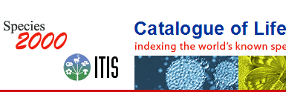

Life cycle of data published in the BDJ
Occurrence data
Any other data
Genome dada
Morphometric data
Biodiversity
manuscript
Phylogenetic data
Image galleries
Environmental
data
XML
MARK UP
Structured text
(data!)
ARTICLES
Biblio-
graphies
Occurrence
data
Taxon treatments
Taxon names
Plazi
Wiki
COL
BHL

Slide 9
What will BDJ publish?
Single taxon treatments and nomenclatural acts
Local/regional and habitat-based checklists
Sampling reports and occasional inventories
Ecological and biological observations of species and communities
Identification keys
Data papers for any biodiversity-related type of data (genomic, phylogenetic, ecological, environmental, etc.)
Descriptions of biodiversity-related software tools and workflows

Slide 10
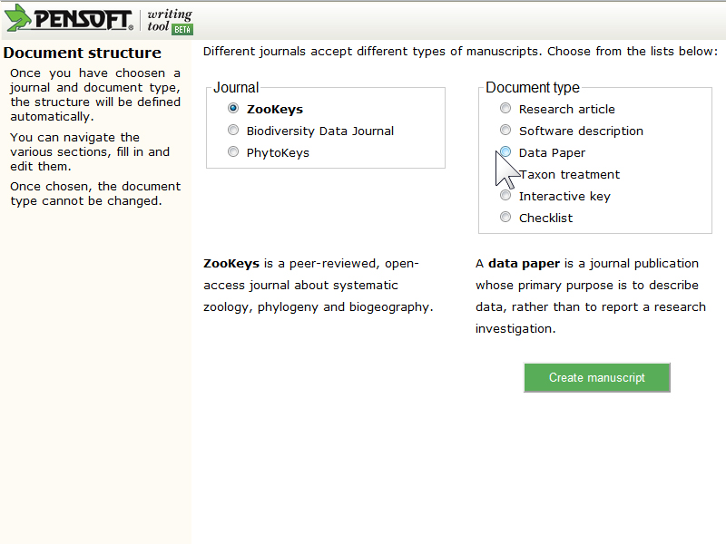
Choose article template

Slide 11
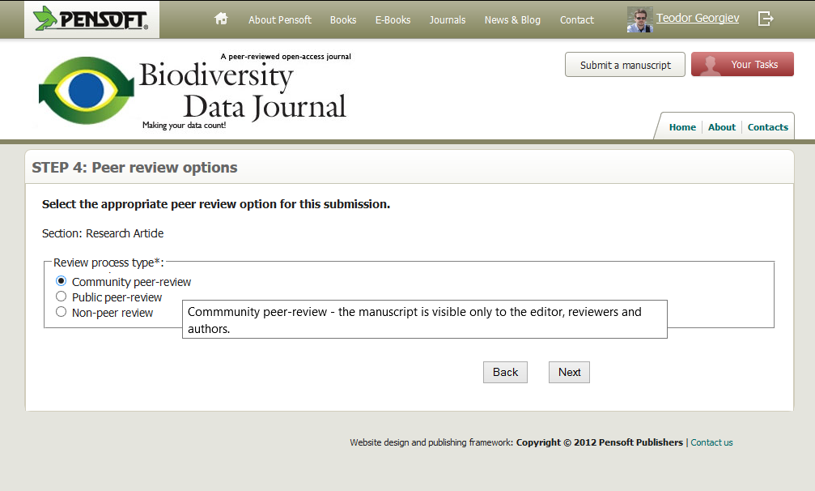
Authors can choose the review type
Notes:
The type of the article determines the possible choices.
For example an editorial can be either non-peer or peer-reviewed,
while a taxonomic paper can only be peer-reviewed.

Slide 12
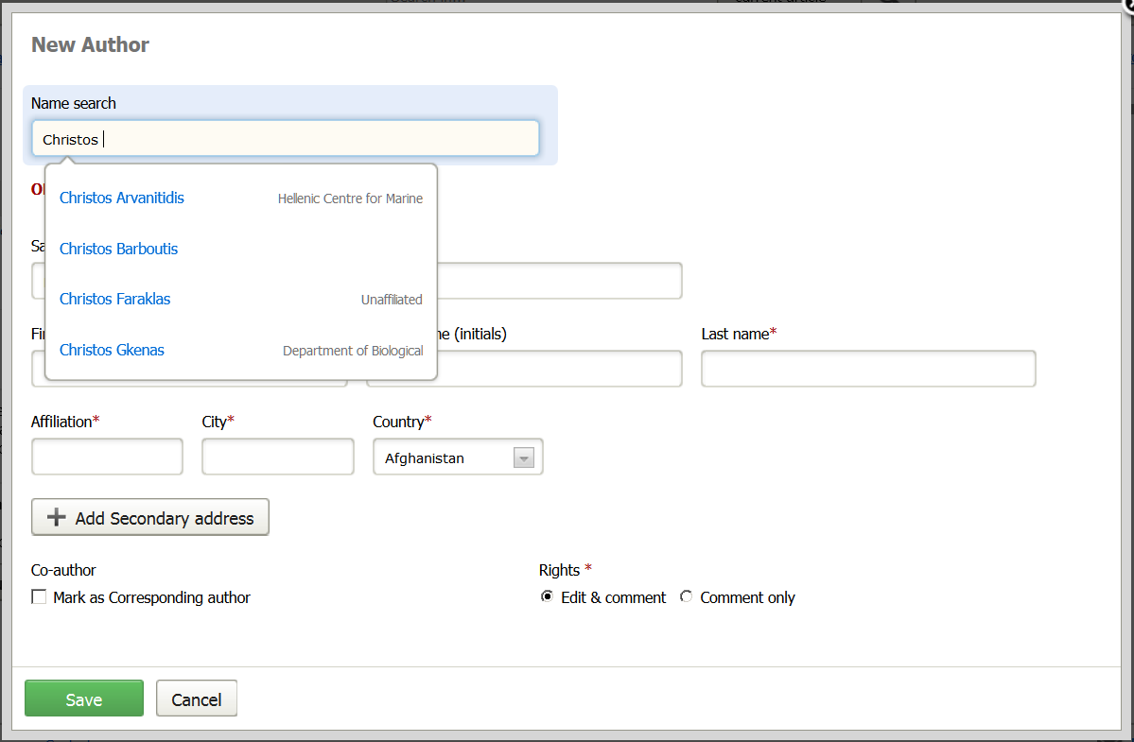
Add author

Slide 13
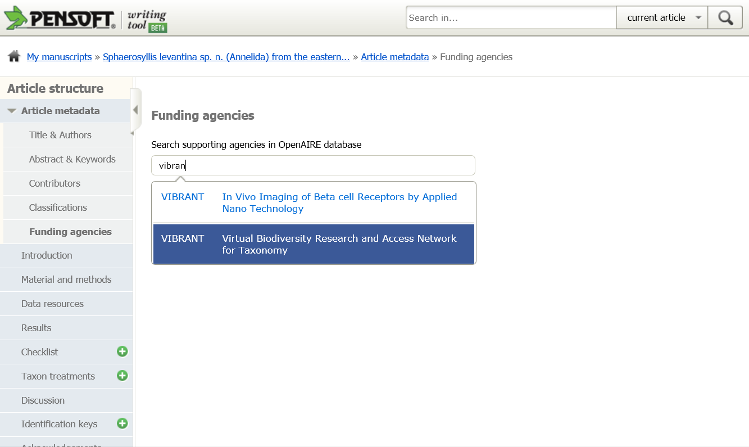

Slide 14
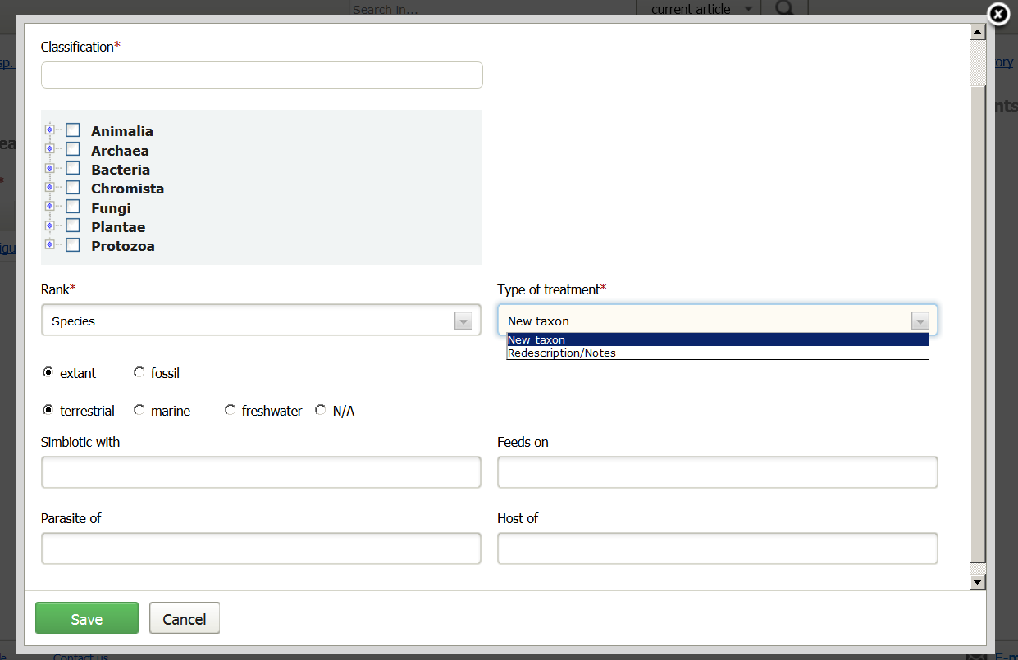

Slide 15
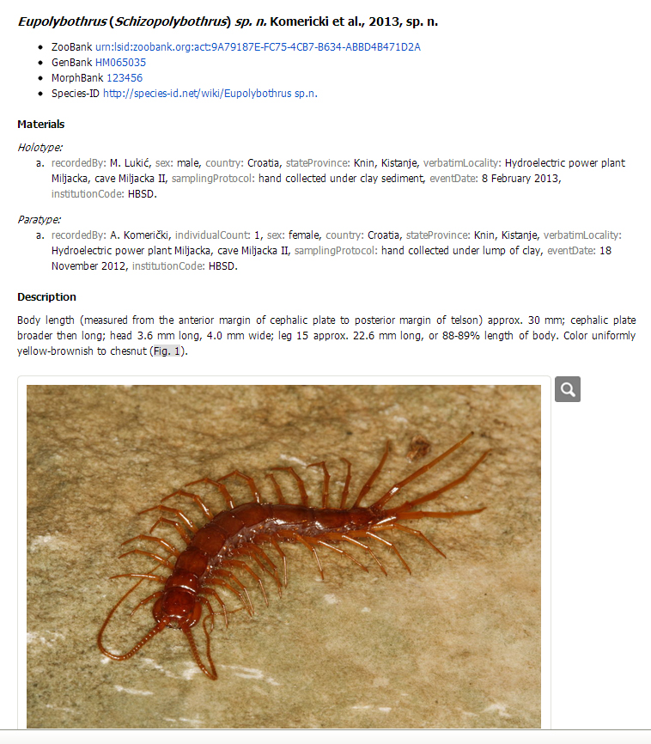
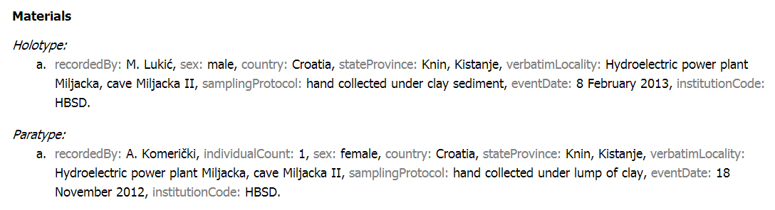
Taxon treatment: new species

Slide 16
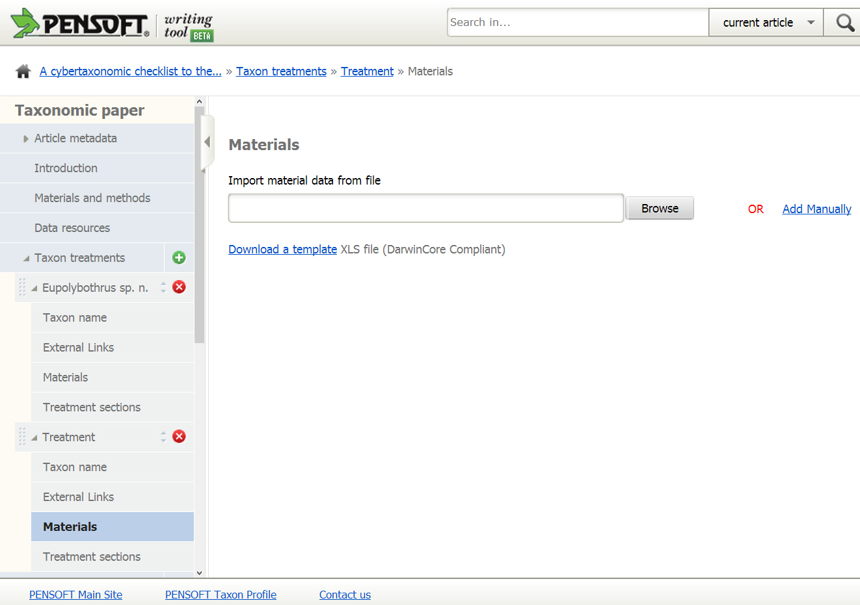
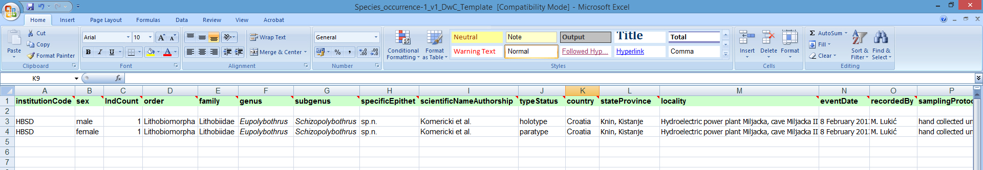
Taxon treatment: import material data

Slide 17
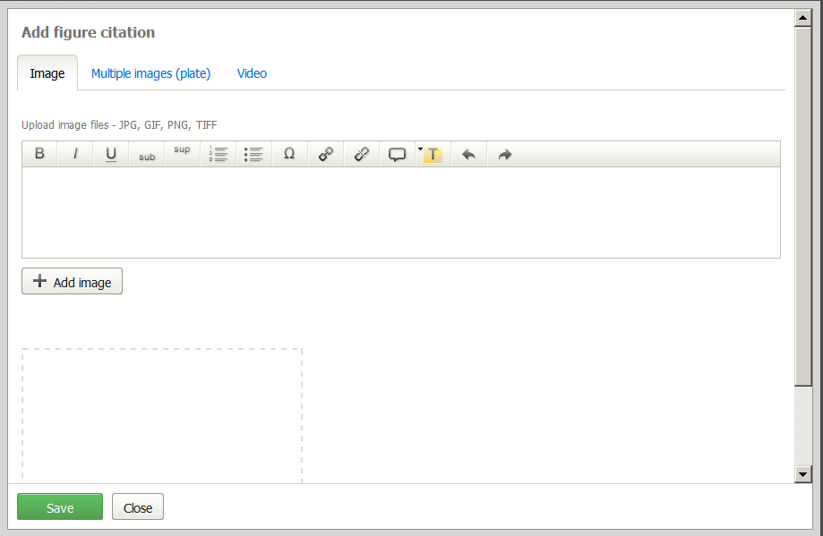
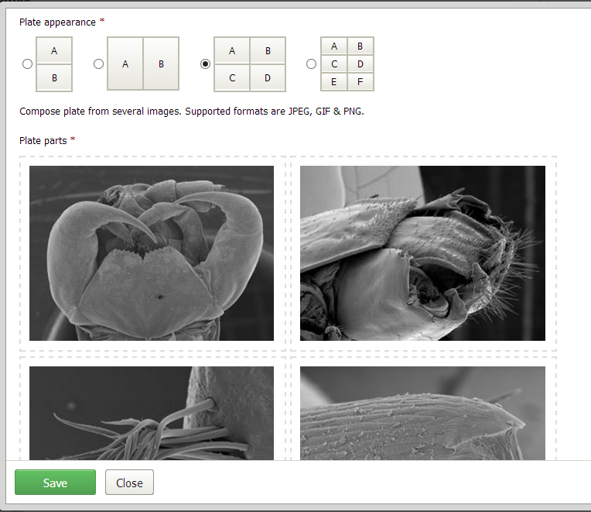
Taxon treatment: upload of images

Slide 18
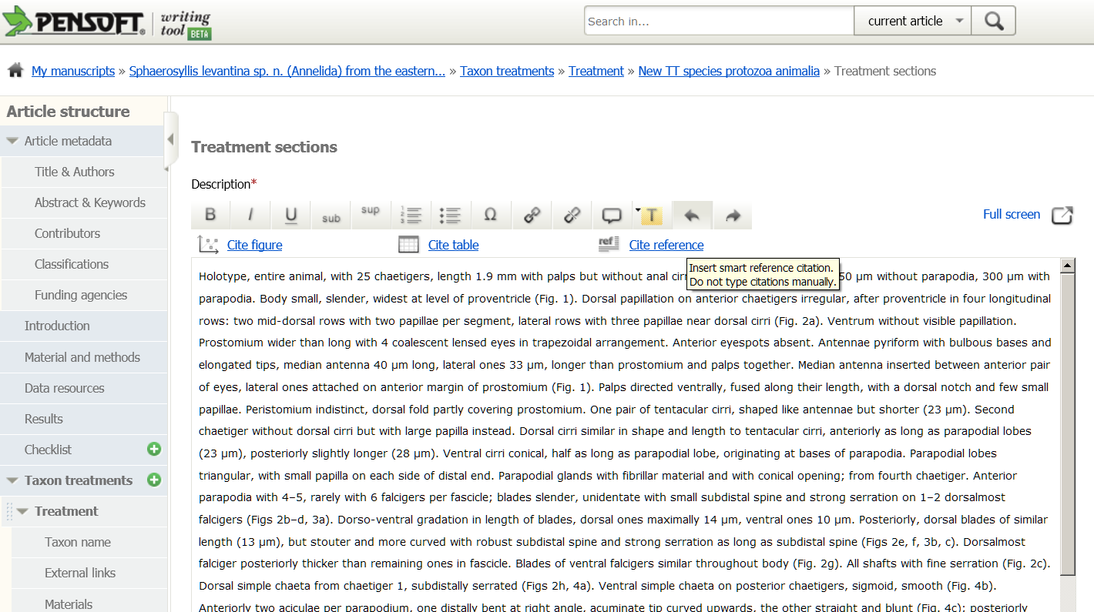

Slide 19
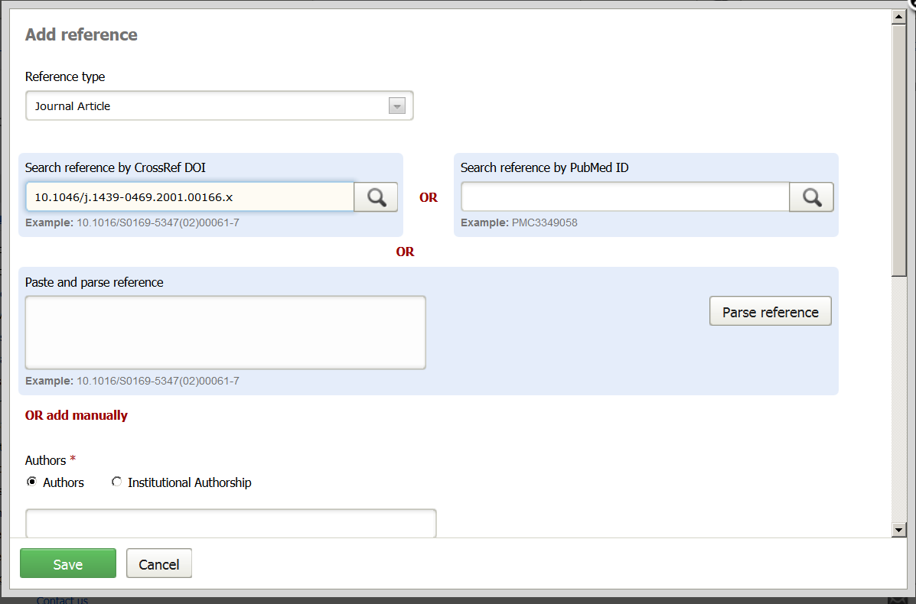

Slide 20
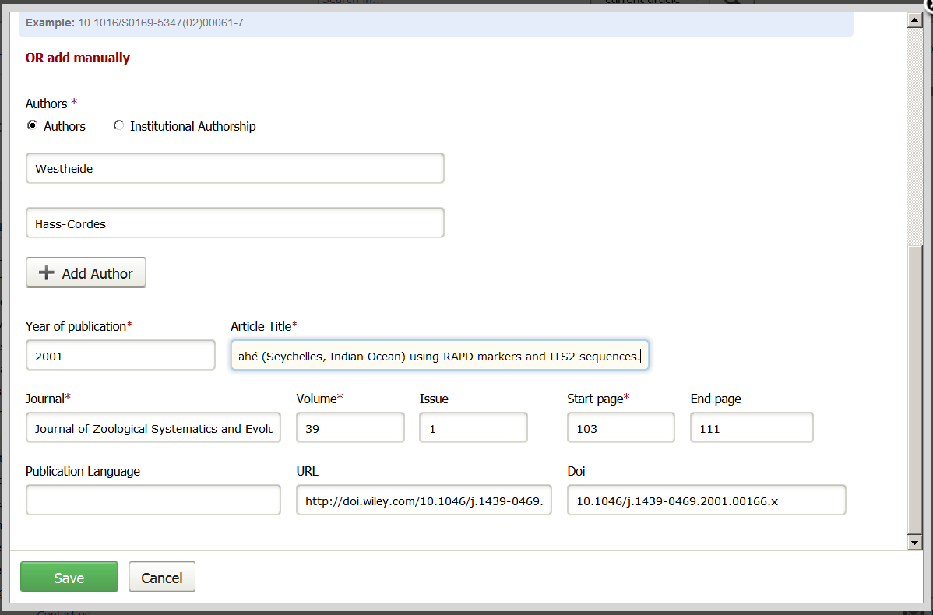

Slide 21
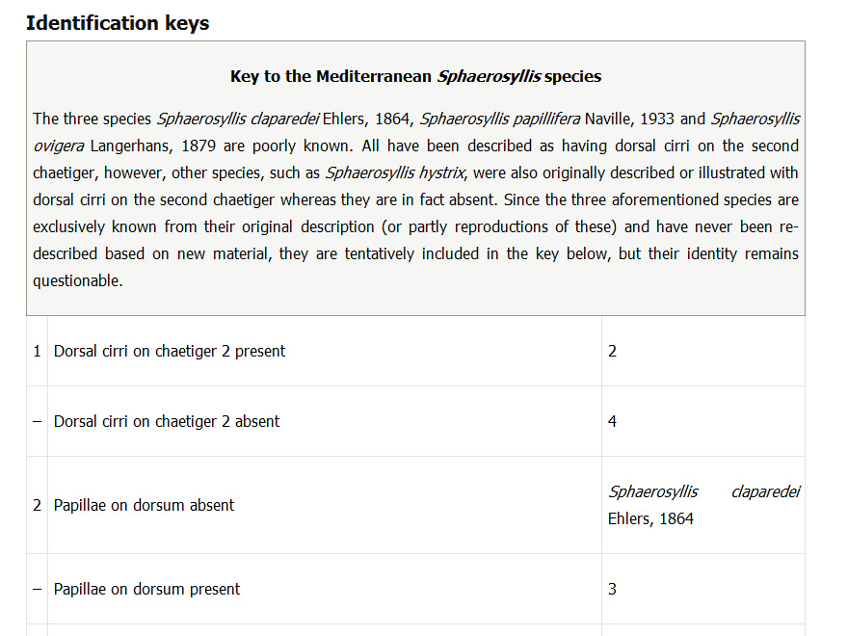
Key preview

Slide 22
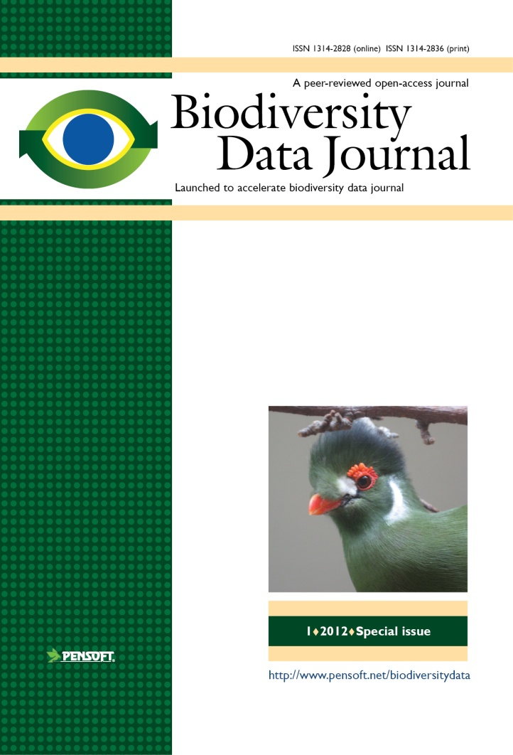

Key features
Biological Codes compliant article templates
No lower/upper limit of manuscript size
Semantically enhanced “articles of the future”
Integrated with GBIF, EOL, Dryad, Scratchpads, etc.
ALL DATA MATTERS!

Slide 23
Manuscripts are automatically formatted during the writing process
Avoids layout stage, decreases costs and efforts!

Slide 24

Automated registration
Manuscript
SUBMISSION
Peer review
XML Query
MANUSCRIPT
ACCEPTED
XML Response
XML article metadata
ARTICLE
PUBLISHED
Taxon name available/valid
(effectively published)

Slide 25
Automated import of treatments from Scratchpads and author’s own databases

Slide 26
No installation!
Just register and go!

Slide 27


Slide 28
NO Author Guidelines!
The tool guides you!

Slide 29
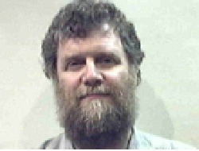
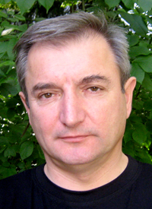





Thank you for your attention!
The Crustacean Society & The Latin American Association of Carcinology
7 -11 July 2013 – San José, Costa Rica
Dave Roberts
Lyubomir Penev
Laurence Livermore
Jeremy Miller
Teodor
Georgiev
Vince Smith
We Open Access!
ViBRANT

